Slide 1
Learn to Program via Visual Programming and micro:bit
A Study Notes

Slide 2
Outline
Intent
What is Visual Programming?
Visual Programming for Learning
IoT Devices and micro:bit
Visual Programming for micro:bit

Slide 3
Intent
To walk-thru a visual programming environment for learning multiple programming languages
JavaScript
Python
Not cover here
C/C++
Lua, …

Slide 4
Visual Programming
In computing, a visual programming language (VPL) is any programming language that lets users create programs by manipulating program elements graphically rather than by specifying them textually. A VPL allows programming with visual expressions, spatial arrangements of text and graphic symbols, used either as elements of syntax or secondary notation.
From [wikipedia](https://en.wikipedia.org/wiki/Visual_programming_language )

Slide 5
Different Types
Computer Programming paradigms
OO, flow-based, …
Programming stage
conceptual, modeling, algorithm, ...
Application Domains
finance, embedded system, education, multimedia, …
System Automation
process, UI, logic validation, …

Slide 6
micro:bit (1/2)

Slide 7
micro:bit (2/2)
micro:bit is an ARM-based embedded system designed by the BBC for use in computer education in the UK, released in February 10th 2016.
The board is 4 cm × 5 cm and has
an ARM Cortex-M0 processor,
powered by either USB or an external battery pack.
Input/Output, Interface
three ring connectors (plus one power one ground) which accept crocodile clips or 4 mm banana plugs
a 23-pin edge connector with two or three PWM outputs, six to 17 GPIO pins (depending on configuration), six analog inputs, serial I/O, SPI, and I²C.
accelerometer and magnetometer sensors,
Bluetooth and USB connectivity,
a display consisting of 25 LEDs, two programmable buttons one reset button.
Software
Programming Language: Javascript, micropython, C/C++, TouchDevelop, Free Pascal
Editor: [pxt](https://makecode.microbit.org/) based on Blockly for JavaScript, [mu](https://www.microbit.co.uk)

Slide 8
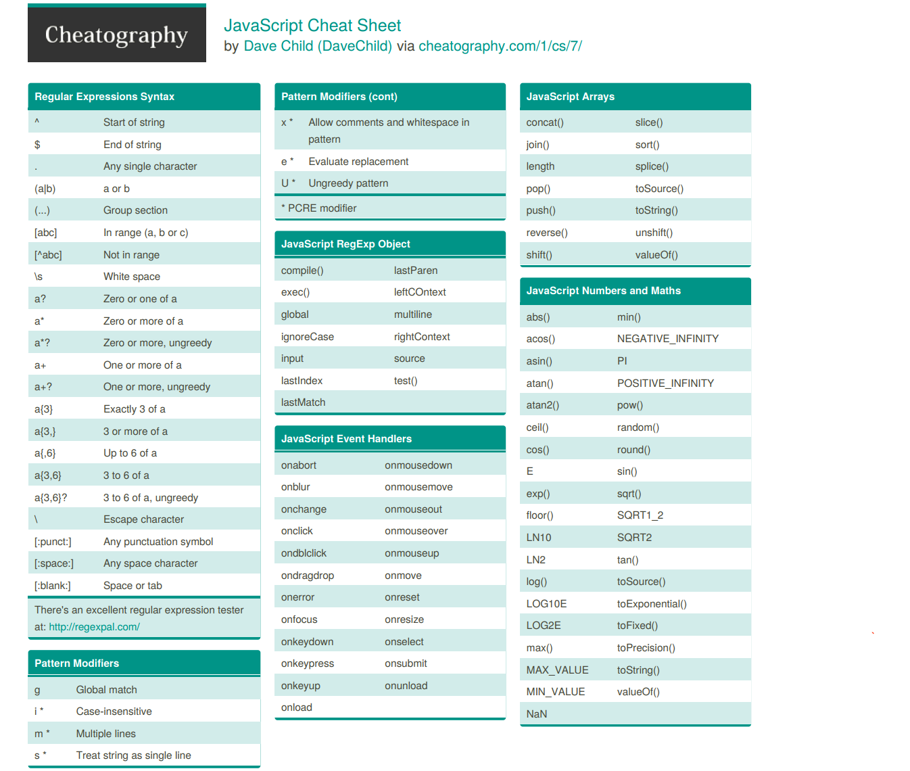
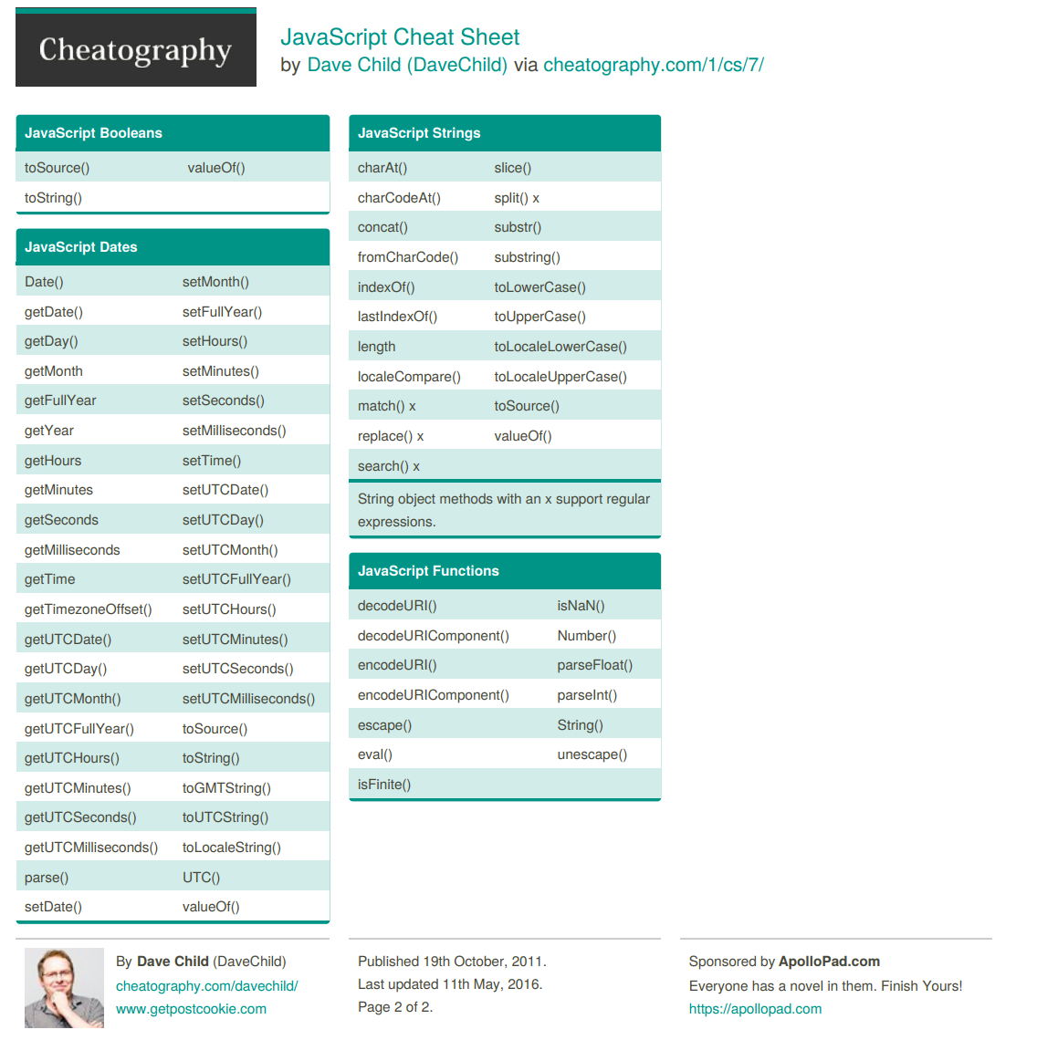
JavaScript Cheat Sheet

Slide 9
MicroPython Summary (supporting library)
array: numeric data arrays
builtins: basic functions
cmath: mathematical functions for complex numbers
gc: garbage collector
math: mathematical functions
select: wait for events on a set of streams
sys: system specific functions
ubinascii: binary/ASCII conversions
ucollections: collection and container types
uhashlib: hashing algorithm
uheapq: heap queue algorithm
uio: input/output streams
ujson: JSON encoding and decoding • uos: basic “operating system” services
ure: regular expressions
usocket: socket module
ustruct: pack and unpack primitive data types
utime: time related functions
uzlib: zlib decompression
uctypes: access binary data in a structured way
[Micropython differences from cpython](https://docs.micropython.org/en/latest/pyboard/genrst/index.html )

Slide 10
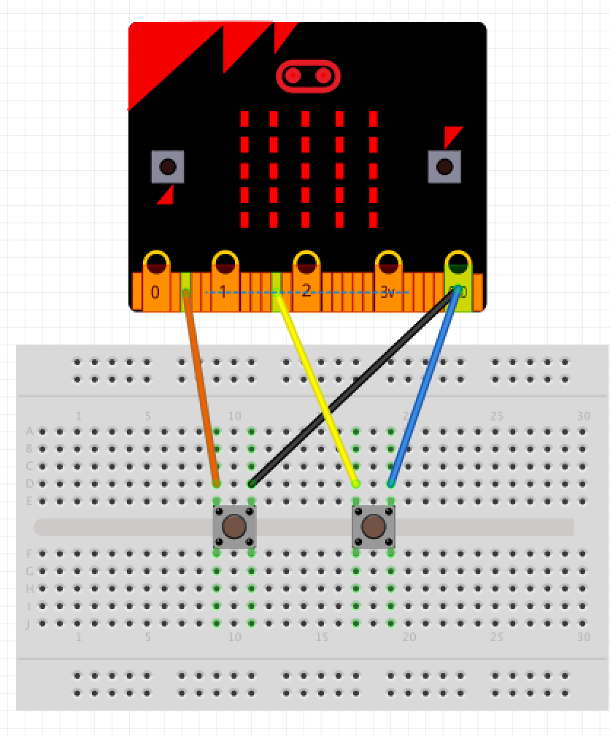
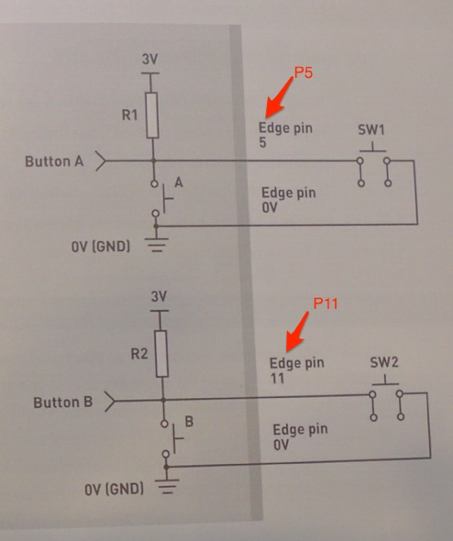
Schematic, Breadboard, and Wiring

Slide 11
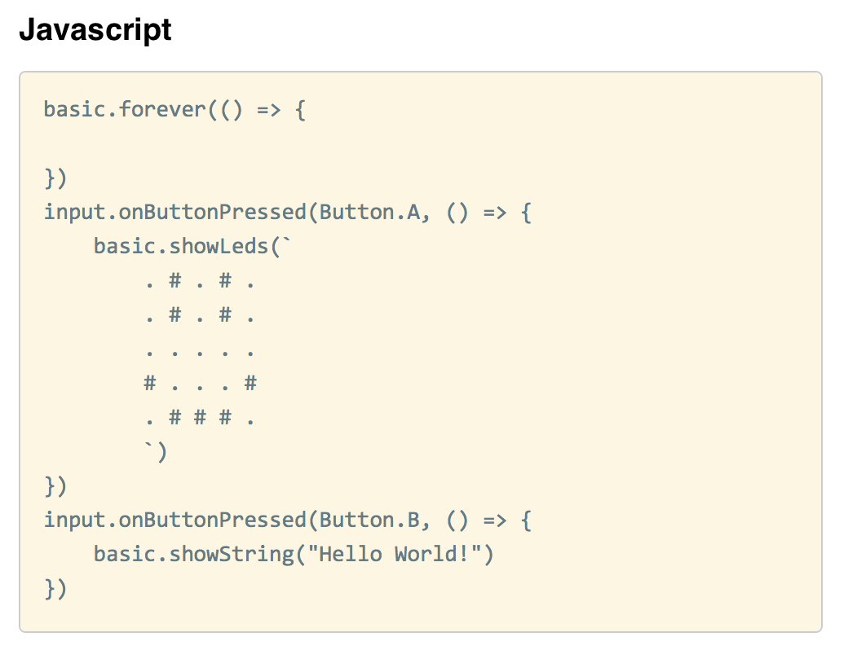
Block and Script in PXT Editor

Slide 12
Microsoft Touch Develop Example Using the Accelerometer to Control Motor Speed

Slide 13
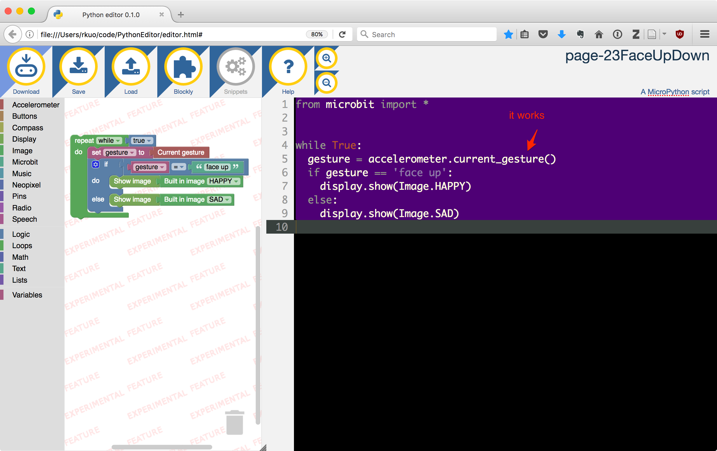
MicroPython Example in Mu Editor open file:///Users/rkuo/code/PythonEditor/editor.html

Slide 14
Review
Gain
Plan
Improve understanding of
Visual Programming Language,
JavaScript, Python.
Gain some hands-on experience on
Microcontroller, sensor, wiring.
Improve knowledge
Prototyping software.
Discover ESP32 microcontroller
Component design in Node-Red, Blockly, App-Inventor.
Domain specific visual programming: data analytics.
Automation control

Slide 15
Supplement Slides

Slide 16
Node-Red

Slide 17
AppInventor

Slide 18
ESP8266 (https://en.wikipedia.org/wiki/ESP8266)
32-bit RISC CPU: Tensilica Xtensa L106 running at 80 MHz*
64 KiB of instruction RAM, 96 KiB of data RAM
External QSPI flash: 512 KiB to 4 MiB* (up to 16 MiB is supported)
IEEE 802.11 b/g/n Wi-Fi
Integrated TR switch, balun, LNA, power amplifier and matching network
WEP or WPA/WPA2 authentication, or open networks
16 GPIO pins
SPI
I²C
I²S interfaces with DMA (sharing pins with GPIO)
UART on dedicated pins, plus a transmit-only UART can be enabled on GPIO2
10-bit ADC (this is a Successive Approximation ADC)
The successor to these microcontroller chips is the ESP32.

Slide 19
